Slide 1
Computer Organization and Architecture
Module 3
Amdahl’s Law – Quantative Principles in Design
Department of Computer Science and Engineering
IIT Kharagpur

Slide 2
AMDAHL’S LAW

Slide 3
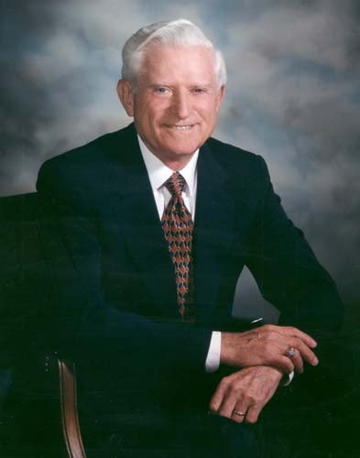
Introduction
Amdahl’s law was established in 1967 by Gene Amdahl.
Basically provides an understanding on scaling, limitations and economics of parallel computing.
Forms the basis for quantitative principles in computer system design.
  Can be applied to other application domains as well.
Gene Amdahl

Slide 4
What is Amdahl’s Law?
It can be used to find the maximum expected improvement of an overall system when only part of the system is improved.
It basically states that the performance improvement to be gained from using some faster mode of execution is limited by the fraction of the time the faster mode can be used.
Very useful to check whether any proposed improvement can provide expected return.
  Used by computer designers to enhance only those architectural features that result in reasonable performance improvement.
  Referred to as quantitative principles in design.

Slide 5
Amdahl’s law demonstrates the law of diminishing returns.
An example:
  Suppose we are improving a part of the computer system that affects only 25% of the overall task.
  The improvement can be very little or extremely large.
  With “infinite” speedup, the 25% of the task can be done in “zero” time.
  Maximum possible speedup = XT_{orig} / XT_{new} = 1 / (1 – 0.25) = 1.33
We can never get a speedup of more than 1.33

Slide 6
Amdahl’s law concerns the speedup achievable from an improvement in computation that affects a fraction F of the computation, where the improvement has a speedup of S.
Before improvement
1 – F
F
After improvement
1 – F
F / S

Slide 7
Execution time before improvement: (1 – F) + F = 1
Execution time after improvement: (1 – F) + F / S
Speedup obtained:
1
(1 – F) + F / S
As S → ∞, Speedup → 1 / (1 – F)
  The fraction F limits the maximum speedup that can be obtained.
Speedup =
$Note: F$ is the fraction of original execution time that is affected by enhancement.
Note that the percentage is wrt. time and not say number of instructions!

Slide 8
1 / (1 – 0.25) = 1.33
Illustration of law of diminishing returns:
  Let F = 0.25.
  The table shows the speedup (= 1 / (1 – F + F / S) for various values of S.
S | Speedup
1 | 1.00
2 | 1.14
5 | 1.25
10 | 1.29
S | Speedup
50 | 1.32
100 | 1.33
1000 | 1.33
100,000 | 1.33

Slide 9
Illustration of law of diminishing returns:
  Let F = 0.75.
  The table shows the speedup for various values of S.
1 / (1 – 0.75) = 4.00
S | Speedup
1 | 1.00
2 | 1.60
5 | 2.50
10 | 3.08
S | Speedup
50 | 3.77
100 | 3.88
1000 | 3.99
100,000 | 4.00

Slide 10
Design Alternative using Amdahl’s law
Loop 1
500 lines
10% of total execution time
Loop 2
20 lines
90% of total execution time

Slide 11
Some examples:
  We make 10% of a program 90X faster, speedup = 1 / (0.9 + 0.1 / 90) = 1.11
  We make 90% of a program 10X faster, speedup = 1 / (0.1 + 0.9 / 10) = 5.26
  We make 25% of a program 25X faster, speedup = 1 / (0.75 + 0.25 / 25) = 1.32
  We make 50% of a program 20X faster, speedup = 1 / (0.5 + 0.5 / 20) = 1.90
  We make 90% of a program 50X faster, speedup = 1 / (0.1 + 0.9 / 50) = 8.47

Slide 12
Example 1
Suppose we are running a set of programs on a RISC processor, for which the following instruction mix is observed:
We carry out a design enhancement by which the CPI of Load instructions reduces from 5 to 2. What will be the overall performance improvement?
Operation | Frequency | CPI_{i}
Load | 20 % | 5
Store | 8 % | 3
ALU | 60 % | 1
Branch | 12 % | 2
W_{i} * CPI_{i} | % Time
1.00 | 0.48
0.24 | 0.12
0.60 | 0.29
0.24 | 0.11
CPI = 2.08
1 / 2.08

Slide 13
Fraction enhanced F = 0.48
Fraction unaffected 1 – F = 1 – 0.48 = 0.52
Enhancement factor S = 5 / 2 = 2.5
Therefore, speedup is
1 1
(1 – F) + F / S 0.52 + 0.48 / 2.5
=
= 1.40

Slide 14
Example 2
The execution time of a program on a machine is found to be 50 seconds, out of which 42 seconds is consumed by multiply operations. It is required to make the program run 5 times faster. By how much must the speed of the multiplier be improved?
  Here, F = 42 / 50 = 0.84
  According to Amdahl’s law,
  5 = 1 / (0.16 + 0.84 / S)
  or, 0.80 + 4.2 / S = 1
  or, S = 21

Slide 15
Example 2a
The execution time of a program on a machine is found to be 50 seconds, out of which 42 seconds is consumed by multiply operations. It is required to make the program run 8 times faster. By how much must the speed of the multiplier be improved?
  Here, F = 42 / 50 = 0.84
  According to Amdahl’s law,
  8 = 1 / (0.16 + 0.84 / S)
  or, 1.28 + 6.72 / S = 1
  or, S = – 24
No amount to speed improvement in the multiplier can achieve this.
Maximum speedup achievable:
1 / (1 – F) = 6.25

Slide 16
Example 3
Suppose we plan to upgrade the processor of a web server. The CPU is 30 times faster on search queries than the old processor. The old processor is busy with search queries 80% of the time. Estimate the speedup obtained by the upgrade.
  Here, F = 0.80 and S = 30
  Thus, speedup = 1 / (0.20 + 0.80 / 30) = 4.41

Slide 17
Example 4
The total execution time of a typical program is made up of 60% of CPU time and 40% of I/O time. Which of the following alternatives is better?
  Increase the CPU speed by 50%
  Reduce the I/O time by half
Assume that there is no overlap between CPU and I/O operations.
CPU
I/O
CPU
I/O
CPU
I/O

Slide 18
Increase CPU speed by 50%
  Here, F = 0.60 and S = 1.5
  Speedup = 1 / (0.40 + 0.60 / 1.5) = 1.25
Reduce the I/O time by half
  Here, F = 0.40 and S = 2
  Speedup = 1 / (0.60 + 0.40 / 2) = 1.25
Thus, both the alternatives result in the same speedup.

Slide 19
Example 5
Suppose that a compute-intensive bioinformatics program is running on a given machine X, which takes 10 days to run. The program spends 25% of its time doing integer instructions, and 40% of time doing I/O. Which of the following two alternatives provides a better tradeoff?
  Use an optimizing compiler that reduces the number of integer instructions by 30% (assume all integer instructions take the same time).
  Optimizing the I/O subsystem that reduces the latency of I/O operations from 10 μsec to 5 μsec (that is, speedup of 2).

Slide 20
Alternative (a):
  Here, F = 0.25 and S = 100 / 70
  Speedup = 1 / (0.75 + 0.25 * 70 / 100) = 1.08
Alternative (b):
  Here, F = 0.40 and S = 2
  Speedup = 1 / (0.60 + 0.40 / 2) = 1.25

Slide 21
Extension to Multiple Enhancements
Suppose we carry out multiple optimizations to a program:
  Optimization 1 speeds up a fraction F₁ of the program by a factor S₁
  Optimization 2 speeds up a fraction F₂ of the program by a factor S₂
1 – F₁ – F₂
F₁
F₂
1 – F₁ – F₂
F₁ / S₁
F₂ / S₂
Speedup
1
(1 – F₁ – F₂) + F₁ / S₁ + F₂ / S₂

Slide 22
In the calculation as shown, it is assumed that F₁ and F₂ are disjoint.
  S₁ and S₂ do not apply to the same portion of execution.
If it is not so, we have to treat the overlap as a separate portion of execution and measure its speedup independently.
  F_{1only} , F_{2only} , and F_{1&2} with speedups S_{1only} , S_{2only} , and S_{1&2}
1 – F_{1only} – F_{2only} – F_{1&2}
F_{1only}
F_{1&2}
F_{2only}
1 – F_{1only} – F_{2only} – F_{1&2}
F_{1only} / S_{1only}
F_{1&2} / S_{1&2}
F_{2only} / S_{2only}
1
(1 – F_{1only} – F_{2only} – F_{1&2}) + F_{1only} / S_{1only} + F_{2only} / S_{2only} + F_{1&2} / S_{1&2}
Speedup =

Slide 23
General expression:
  Assume m enhancements of fractions F₁, F₂, …, F_{m} by factors of S₁, S₂, …, S_{m} respectively.

Slide 24
Example 6
Consider an example of memory system.
  Main memory and a fast memory called cache memory.
  Frequently used parts of program/data are kept in cache memory.
  Use of the cache memory speeds up memory accesses by a factor of 8.
  Without the cache, memory operations consume a fraction 0.40 of the total execution time.
  Estimate the speedup.
Main Memory
CPU
Cache Memory
Solution
1
(1 – F) + F / S
1
(1 – 0.4) + 0.4 / 8
Speedup =
=
= 1.54

Slide 25
Example 7
Now we consider two levels of cache memory, L1-cache and L2-cache.
Assumptions:
  Without the cache, memory operations take 30% of execution time.
  The L1-cache speeds up 80% of memory operations by a factor of 4.
  The L2-cache speeds up 50% of the remaining 20% memory operations by a factor of 2.
We want to find out the overall speedup.

Slide 26
Solution:
  Memory operations = 0.3
  F_{L1} = 0.3 * 0.8 = 0.24
  S_{L1} = 4
  F_{L2} = 0.3 * (1 – 0.8) * 0.5 = 0.03
  S_{L2} = 2
Speedup
1
(1 – F_{L1} – F_{L2}) + F_{L1} / S_{L1} + F_{L2} / S_{L2}
1
(1 – 0.24 – 0.03) + 0.24 / 4 + 0.03 / 2
= 1.24

Slide 27
Example 8
Consider a memory system with two levels of cache memory, L1 and L2. Without the cache, memory operations consume 45% of the total execution time. It is experimentally found that the L1-cache speeds up 92% of all memory operations by a factor of 5, while the L2-cache speeds up 60% of the remaining memory operations by a factor of 2.5. Calculate the overall speedup achieved by using the cache memories using Amdahl’s law.

Slide 28
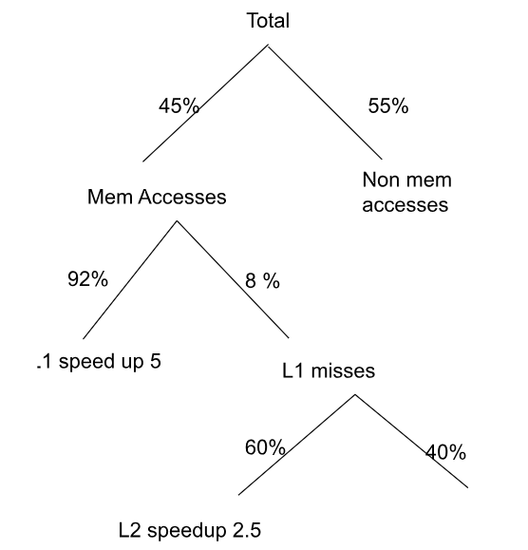

By Amdahl’s Law,
  Memory operations = 0.45
  F_{L1} = 0.45 * 0.92
  S_{L1} = 5
  F_{L2} = 0.45 * 0.08 * 0.6
  S_{L2} = 2.5
Overall Speed up:

Slide 29
Example 9
Consider a program with 50 Billion instructions.
Clock frequency is 2GHz.
Say, an architectural modification enhances the branch instruction so that its CPI goes from 4 to 2.
Instruction Type | % of all instructions in a program | CPI
Arithmetic | 40 | 1
Branch | 20 | 4
Load | 30 | 2
Store | 10 | 3
What is the overall SpeedUp?

Slide 30
Example 9 (contd.)
Consider a program with 50 Billion instructions.
Clock frequency is 2GHz.
Say, an architectural modification enhances the branch instruction so that its CPI goes from 4 to 2.
Instruction Type | % of all instructions in a program | CPI
Arithmetic | 40 | 1
Branch | 20 | 4
Load | 30 | 2
Store | 10 | 3
SpeedUp=$\frac{1}{0.8+\frac{0.2}{2}}=\frac{1}{0.9}=1.111$

Slide 31
Example 9 (contd.)
Consider a program with 50 Billion instructions.
Clock frequency is 2GHz.
Say, an architectural modification enhances the branch instruction so that its CPI goes from 4 to 2.
Instruction Type | % of all instructions in a program | CPI
Arithmetic | 40 | 1
Branch | 20 | 4
Load | 30 | 2
Store | 10 | 3
Wrong!
SpeedUp=$\frac{1}{0.8+\frac{0.2}{2}}=\frac{1}{0.9}=1.111$

Slide 32
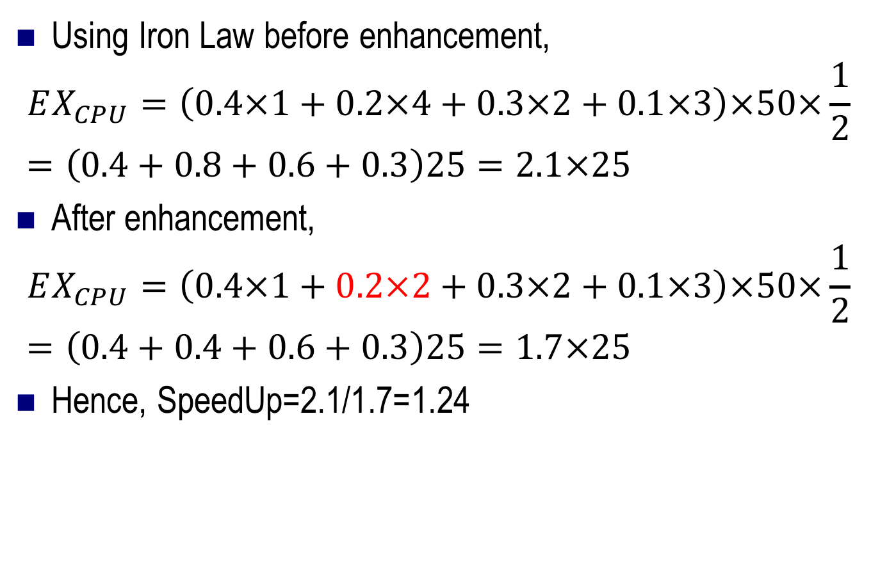
Correct Solution
Using Iron Law before enhancement,
$$EX_{CPU}=\left(0.4×1+0.2×4+0.3×2+0.1×3\right)×50×\frac{1}{2}=\left(0.4+0.8+0.6+0.3\right)25=2.1×25$$
After enhancement,
$$EX_{CPU}=\left(0.4×1+0.2×2+0.3×2+0.1×3\right)×50×\frac{1}{2}=\left(0.4+0.4+0.6+0.3\right)25=1.7×25$$
Hence, SpeedUp=2.1/1.7=1.24

Slide 33
Comparison across various architectural types
Evaluate the following expression
RES = (A * (B – C)) + (D / (E + F))
Using
  Stack Architecture:
    PUSH X, POP X, ADD, SUB, MUL, DIV
  Accumulator Architecture
    LOAD X, STORE X, ADD X, SUB X
  Memory-memory architecture
    ADD X,Y,Z
  Load-store Architecture
    LOAD R, X; STORE Y, R

